Slide 1
Task 14: Final Presentation

Slide 2
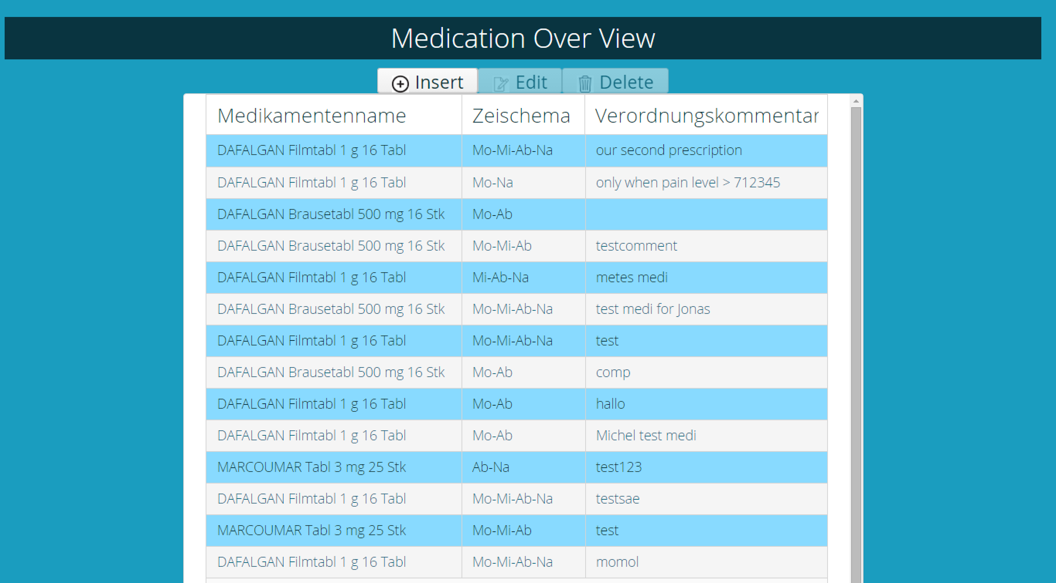
Demo

Slide 3
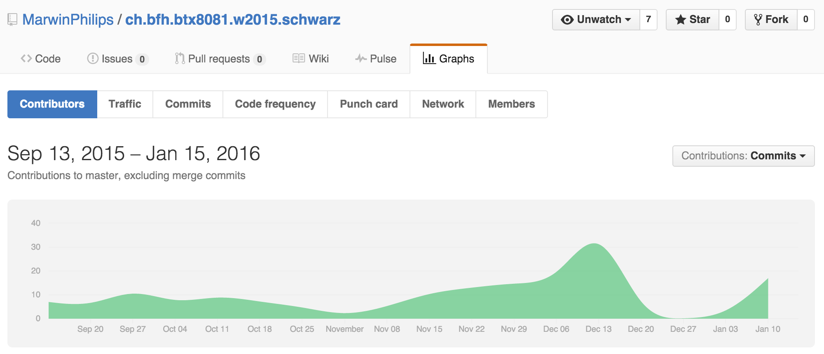
Contributions

Slide 4
<Platzhalter für jedes Teammitglied>

Slide 5
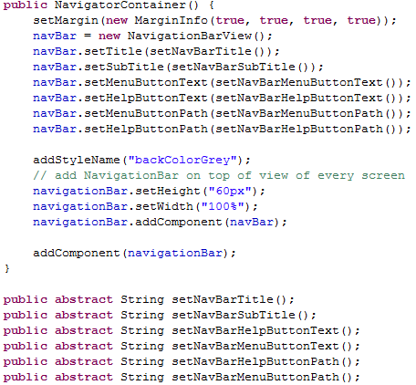
Contribution Jonas Mosimann
NavigationBar functionality
General Bugfixing
Tests for validation

Slide 6

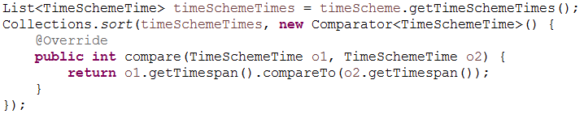
Contribution Marwin Philips
Database connectivity
General support for team members

Slide 7
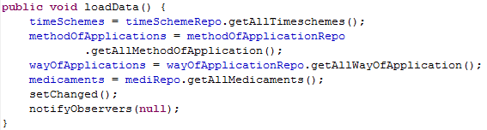
Contribution Mete Turna
Class: MedicationEditModel
Function: Read-, Edit- & Update Prescription
Methode: loadData()

Slide 8
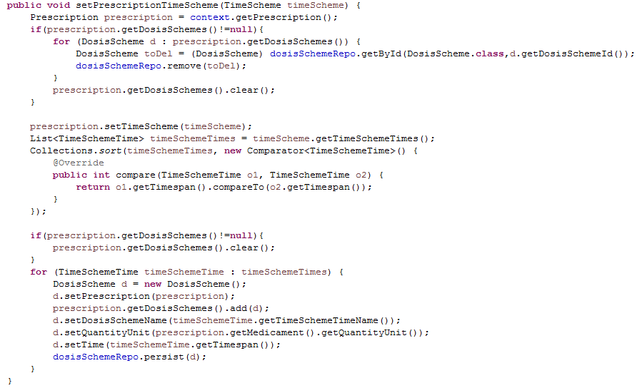
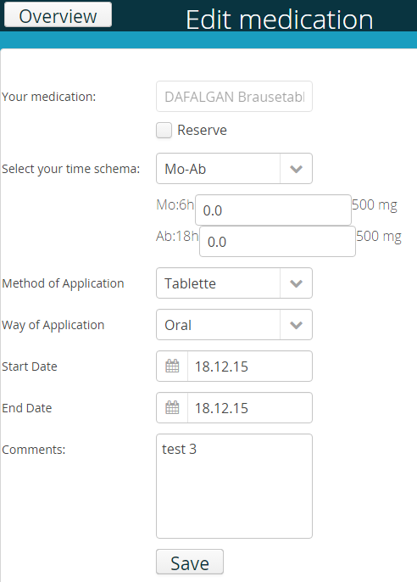
Contribution Mete Turna

Slide 9
Contribution Mete Turna
Classe: MedicationEditModel
Function: Read-, Edit- & Update-Prescription
Methode: loadData(), setPrescriptionTimeScheme(…)
Difficulties: Read & Update von PrescriptionTimeS.(…)
Validation:

Slide 10
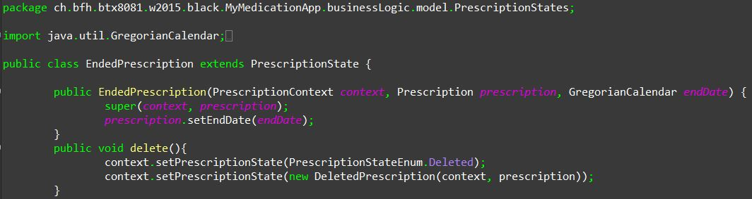
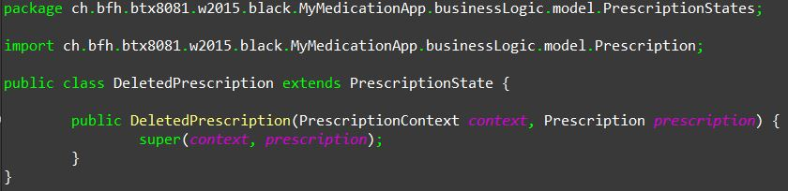
Contribution Michel Murbach
Deleting a new prescription
Aufruf der Methode

Slide 11
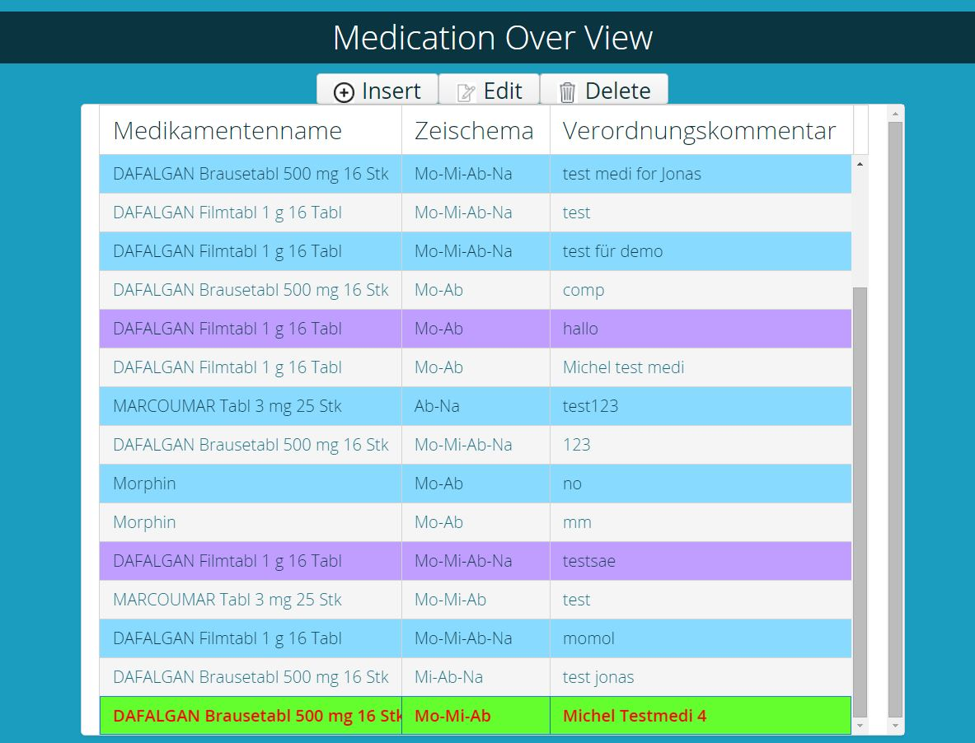
Contribution Michel Murbach
Deleting a new prescription

Slide 12
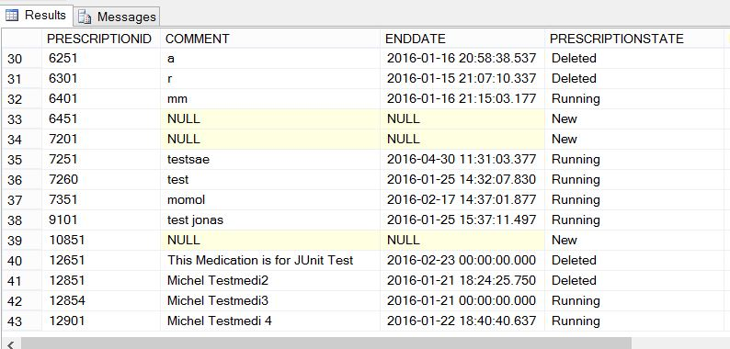
Contribution Michel Murbach
Deleting a new prescription

Slide 13
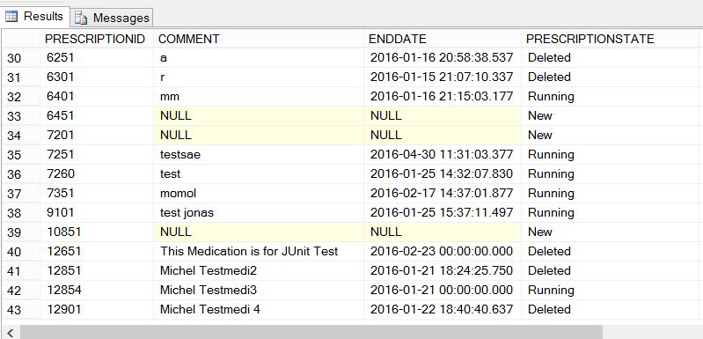
Contribution Michel Murbach
Deleting a new prescription

Slide 14
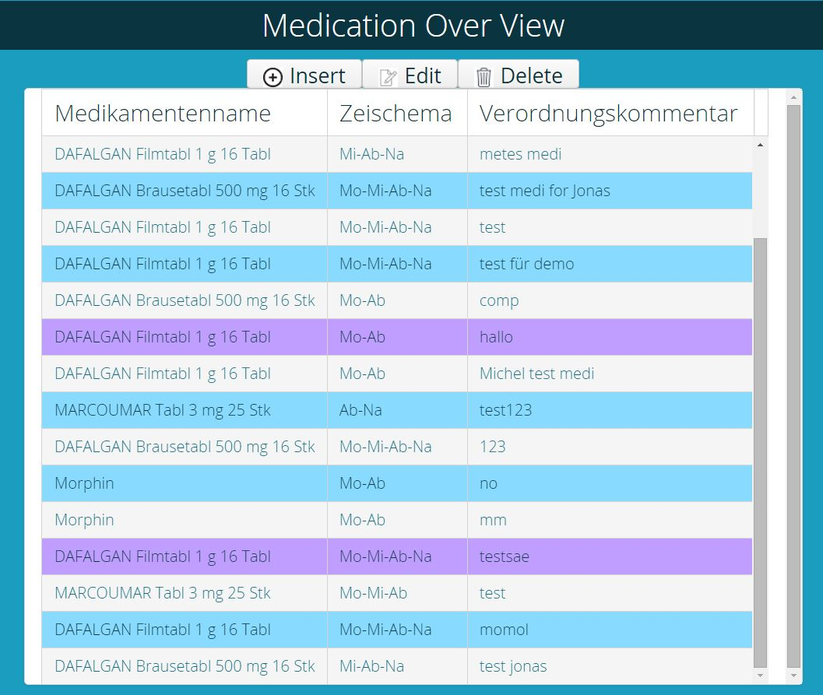
Contribution Michel Murbach
Deleting a new prescription

Slide 15
Contribution Carole Kaiser
Creating Overview of Medication
Styling all Element with mytheme.scss
Support / Pair Programming other Teammembers
Test Classes MsssqlRepository and PerscriptionRepository

Slide 16
Contribution Amin Ghodrati
Creating Overview of Medication
Creating MedicationInsertView
mytheme.scss
Panel Alignment
Table selected row

Slide 17
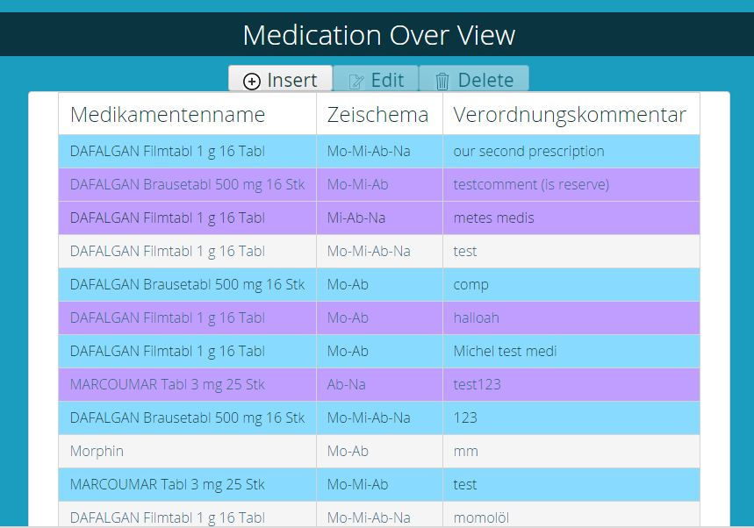
MedicationOverView

Slide 18
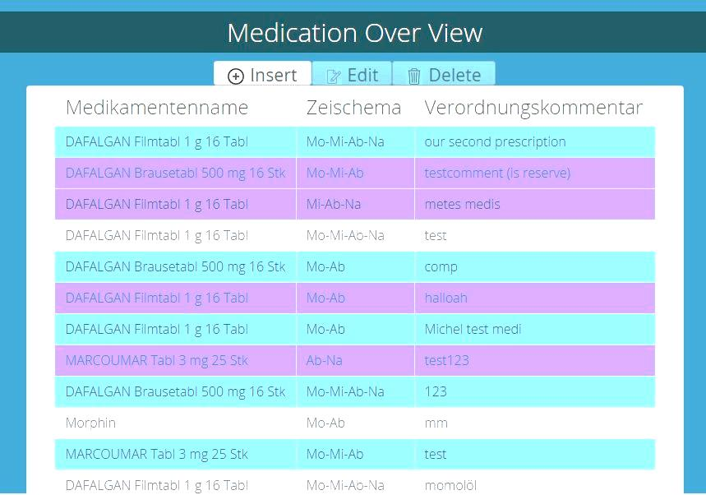
MedicationOverView

Slide 19
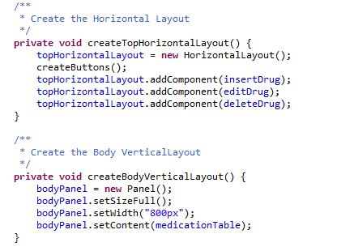
MedicationOverView

Slide 20
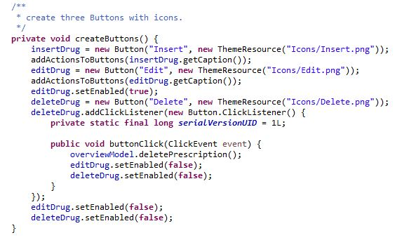
MedicationOverView

Slide 21
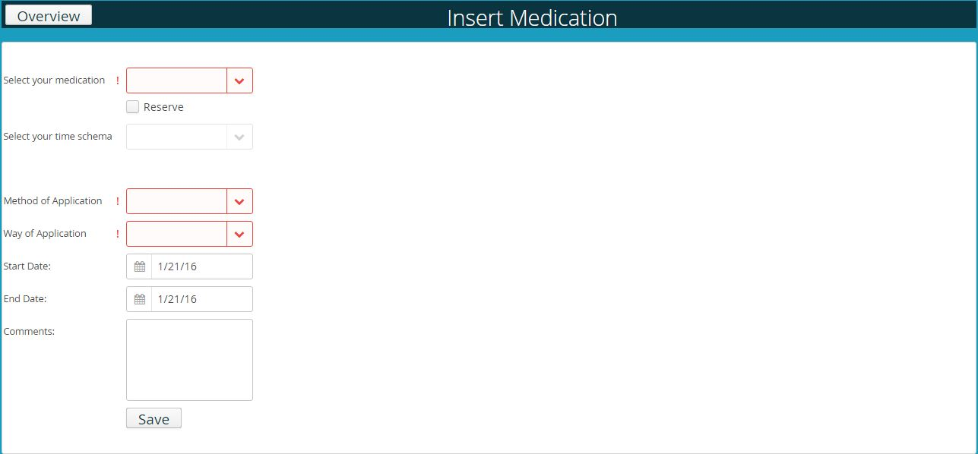
Creating MedicationInsertView

Slide 22
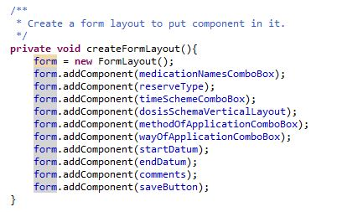
Creating MedicationInsertView

Slide 23
mytheme.scss
Panel Alignment
.v-panel {
width: 730px;
text-align: center;
alignment: center;
}

Slide 24
mytheme.scss
Table selected row
.v-table .v-selected[class*="-row"] {
background-color: #093440;
background-image: none;
background-origin: border-box;
border: solid;
color: #FFFFFF;
font-weight: bold;
}

